Slide 1
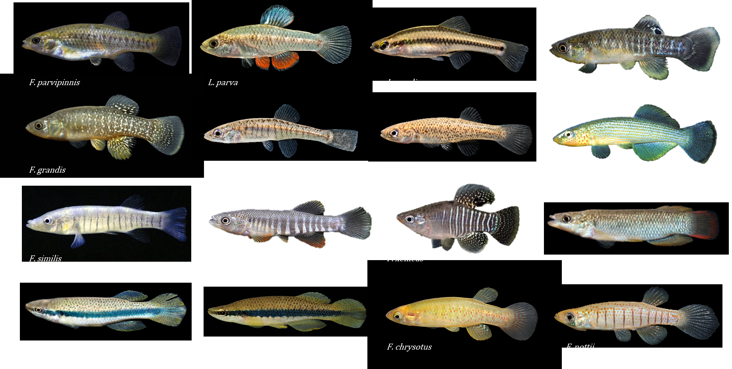
Parallel and divergent gene regulatory responses to salinity stress across 14 species of killifish with diverse osmotic physiologies
Joe McGirr and Lisa Johnson

Slide 2
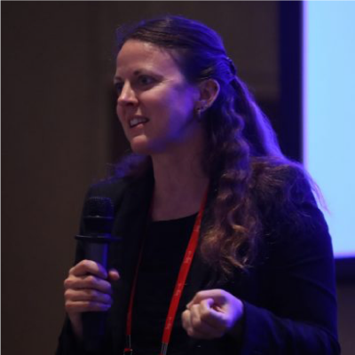
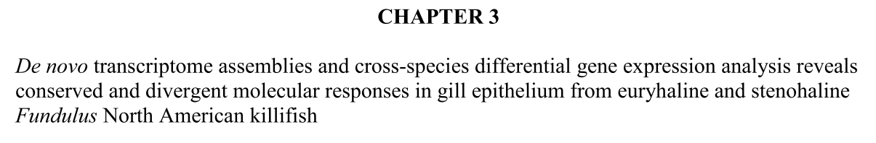
Acknowledgements
Lisa Johnson

Slide 3
Acknowledgements
Lisa Johnson
Reid Brennan
Noah Reid
David Rocke
Blythe Durbin-Johnson
Jen Roach
Titus Brown
Andrew Whitehead

Slide 4

Acknowledgements

Slide 5
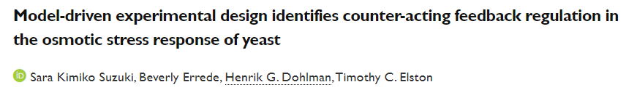

Slide 6
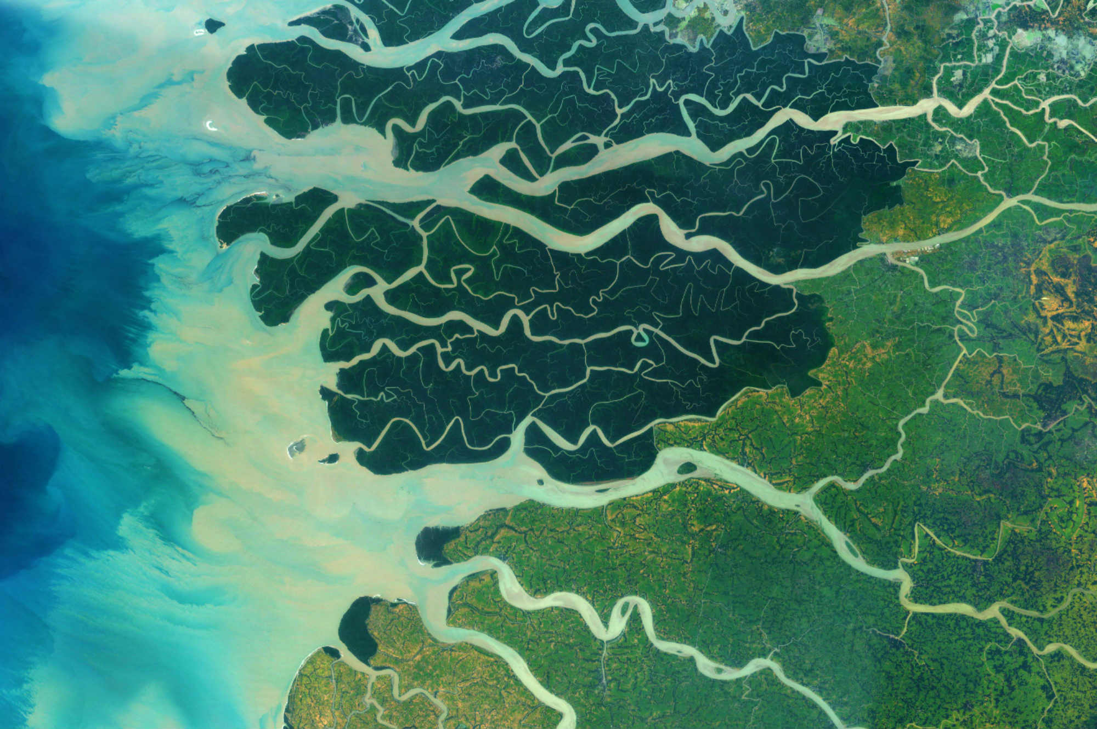
Habitat salinity determines species survival and distribution
Fresh water
>0.5 ppt
Brackish
0.5 - 30 ppt
Salt water
30 - 40 ppt

Slide 7

Maintaining an internal osmolarity that is different from the environment
Freshwater Saltwater
Ion uptake
through gills
Ion export
through gills
Na⁺ Cl⁻
Na⁺ Cl⁻

Slide 8
Most species are Stenohaline tolerate a small range of salinity stress
Freshwater Saltwater
Ion uptake
through gills
Ion export
through gills
Na⁺ Cl⁻
Na⁺ Cl⁻

Slide 9
Some species are Euryhaline tolerate a larger range of salinity stress
Freshwater Saltwater
Ion uptake
through gills
Ion export
through gills
Na⁺ Cl⁻
Na⁺ Cl⁻

Slide 10
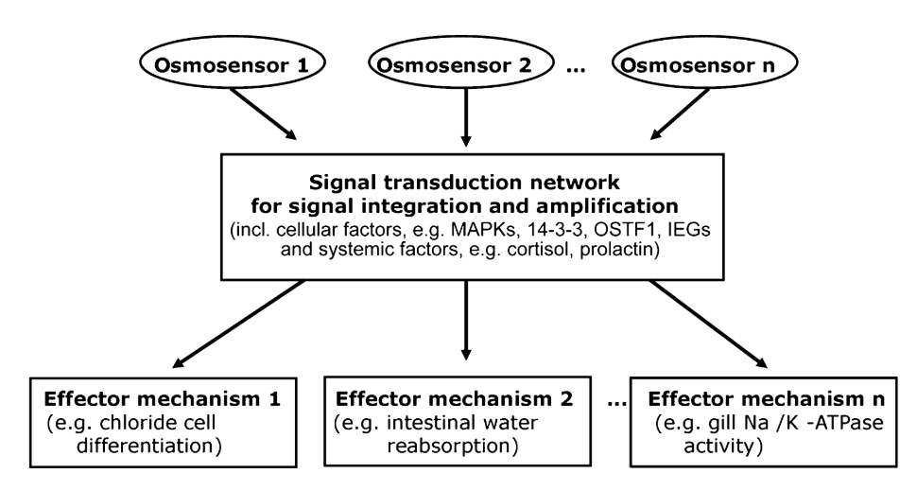
Mechanisms underlying flexibility Osmosensing: sensory stimuli trigger signaling pathways that cause physiological and structural alterations allowing switches between salt secretion and salt absorption
Fiol and Kultz 2007

Slide 11
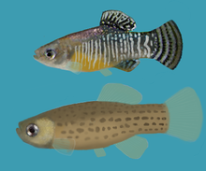
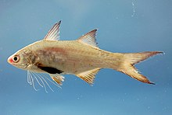
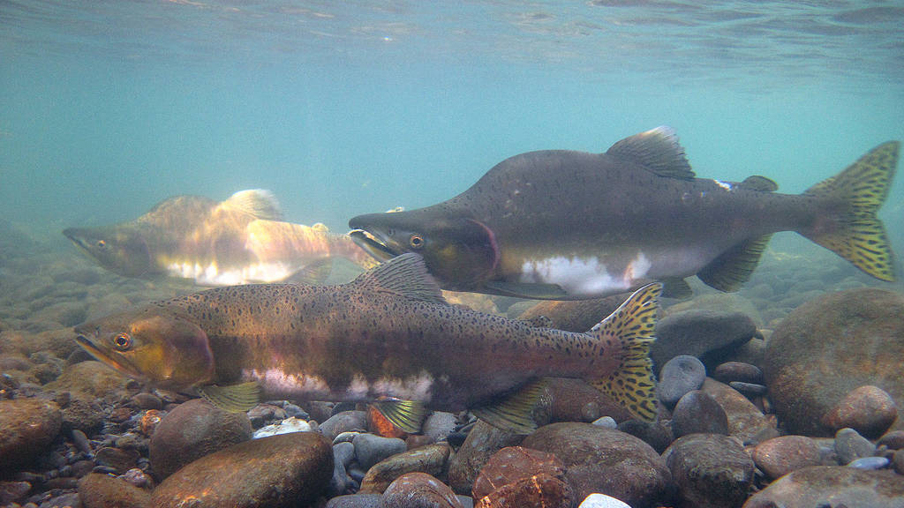
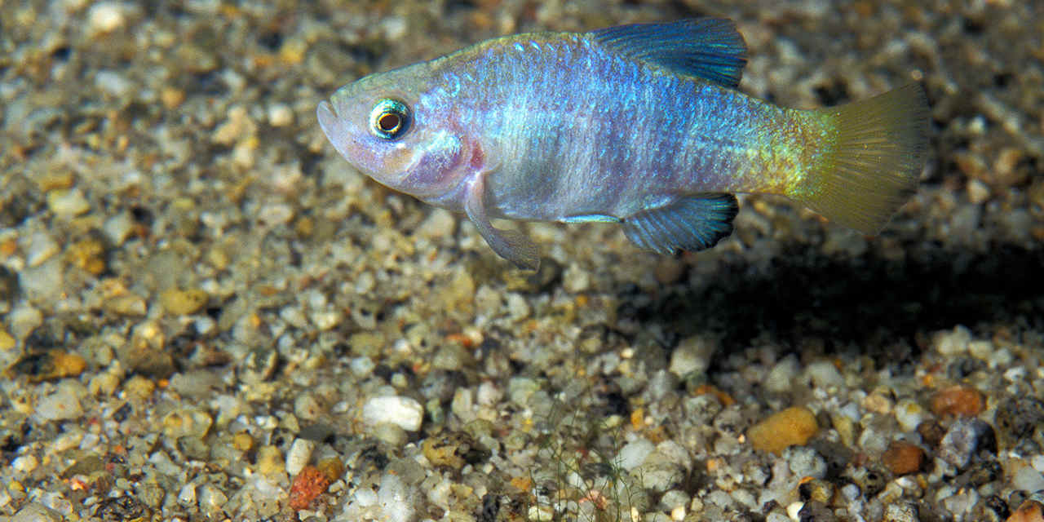
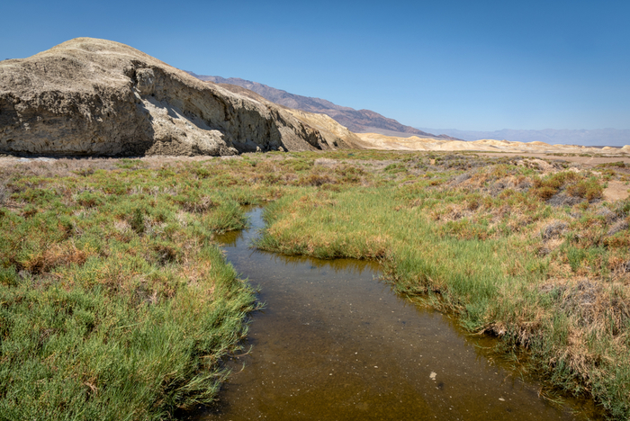
Euryhaline species are adapted to habitats with fluctuating salinity
coastal regions
arid regions

Slide 12
Euryhaline physiologies are likely important during evolutionary transitions from generalist to specialist phenotypes
Saltwater
Stenohaline specialists
Euryhaline generalists
Freshwater
Stenohaline specialists

Slide 13
Euryhaline physiologies are likely important during evolutionary transitions from generalist to specialist phenotypes
Saltwater
Stenohaline specialists
Euryhaline generalists
Freshwater
Stenohaline specialists

Slide 14
Climate change increases the frequency of salinity stress and fluctuation
Melting ice caps will cause a average decrease in ocean salinity.
Rising sea level leads to increased salinization of coastal areas from seawater invasion into freshwater.
More frequent and severe hurricanes and tsunamis will cause large and sudden fluctuations in habitat salinity.

Slide 15
Goal: Identify molecular mechanisms underlying transitions from euryhaline to stenohaline physiologies
Fiol and Kultz 2007

Slide 16
Goal: Identify molecular mechanisms underlying transitions from euryhaline to stenohaline physiologies
Better understand genetic constraints on the evolution of tolerant physiologies.
Help us predict how populations might respond to strong selection pressure from increased salinity stress.
Fiol and Kultz 2007

Slide 17
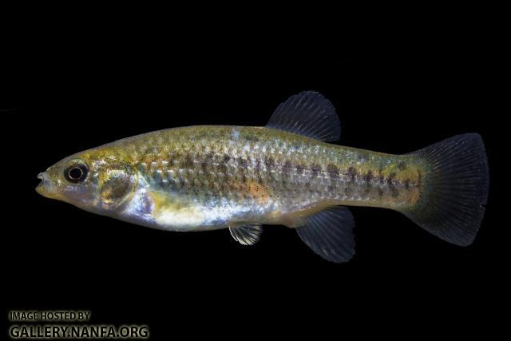
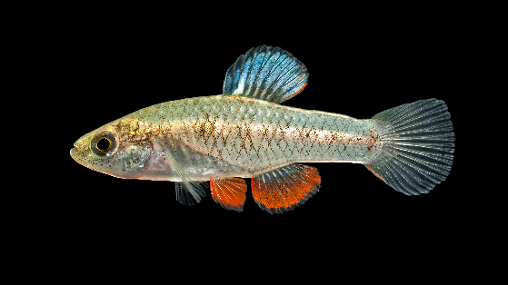
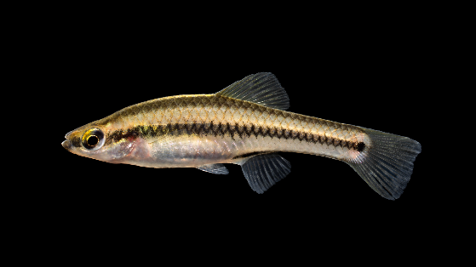
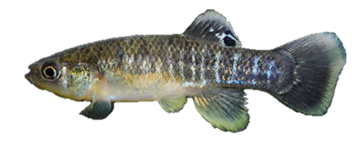
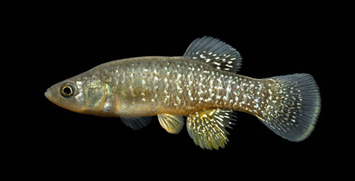
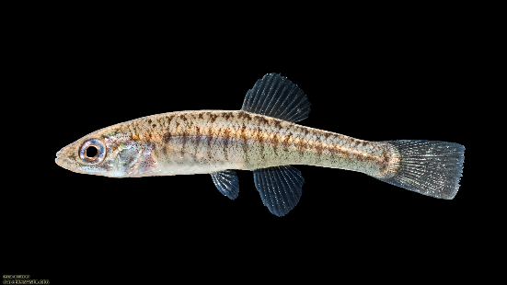
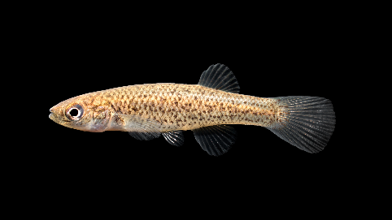
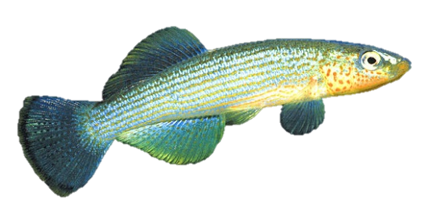
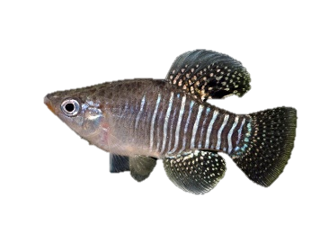
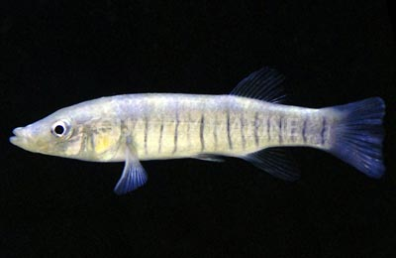
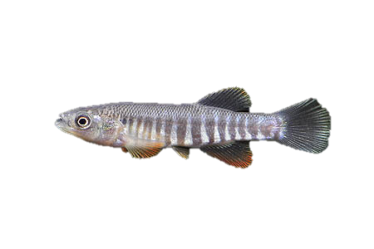
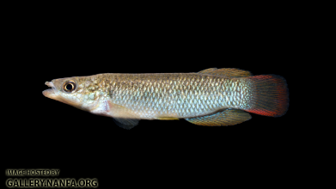
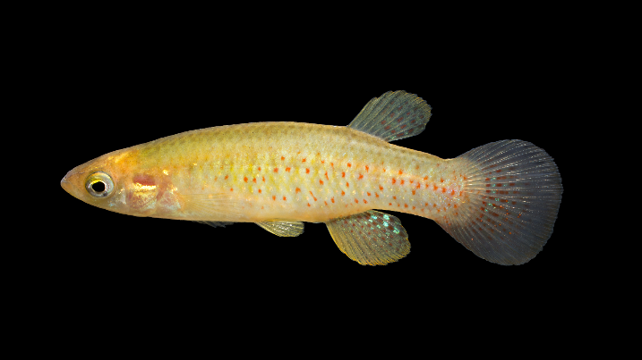
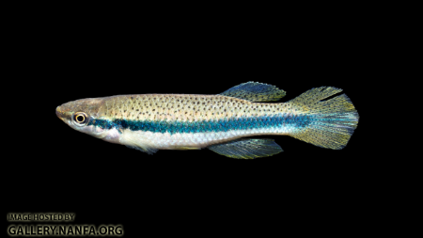
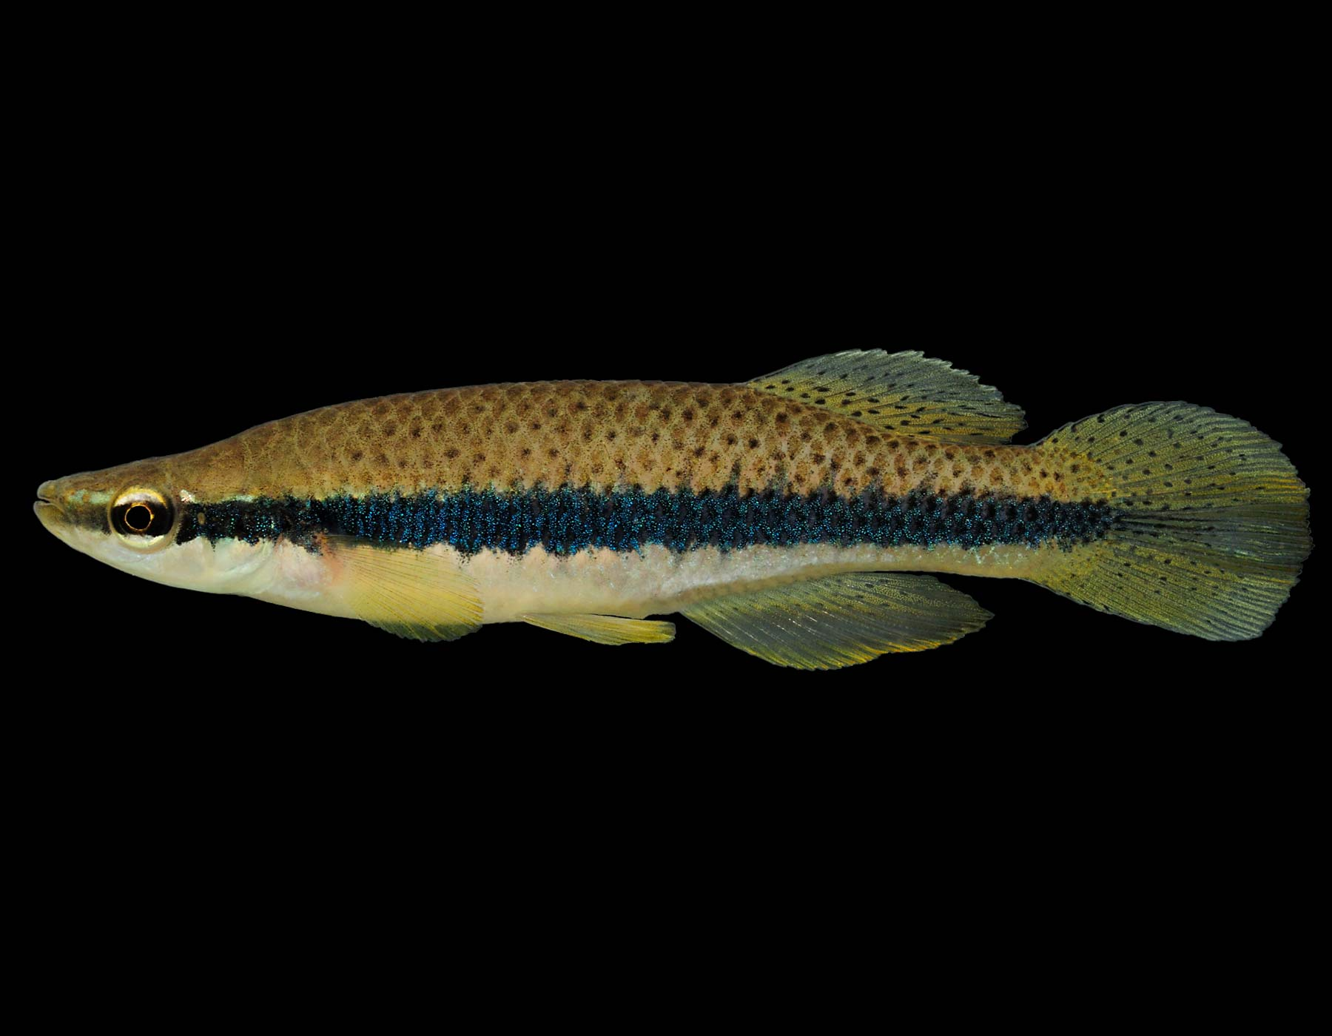
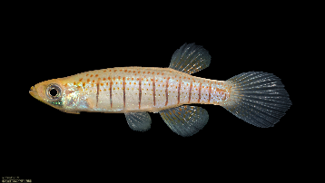
Evolutionary radiation of osmotolerant physiologies in killifish
F. parvipinnis L. parva L. goodie F. heteroclitus
F. grandis F. diaphanus F. rathbuni F. catenatus
F. similis F. zebrinus F. xenicus F. sciadicus
F. olivaceus F. notatus F. chrysotus F. nottii

Slide 18
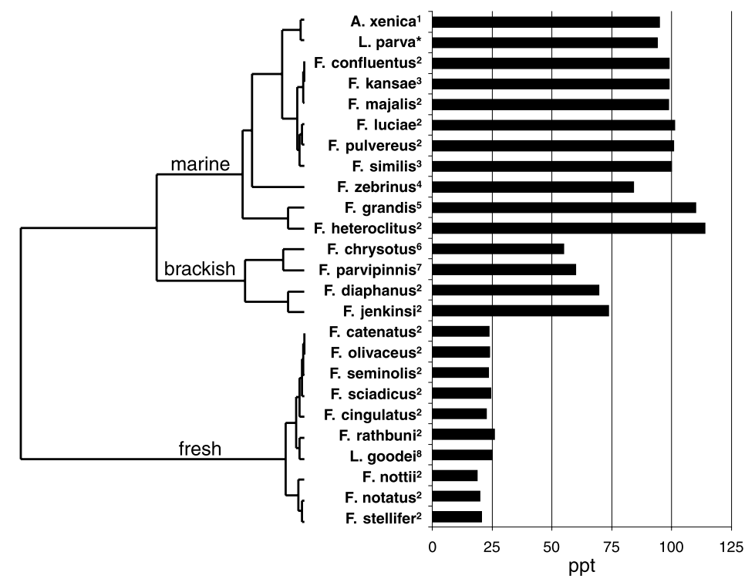
Evolutionary radiation of osmotolerant physiologies in killifish
Tolerance limits for each species following a gradual transfer from lower salinities.
Species grouped by similarities in tolerance, not phylogenetic relationships.
Whitehead 2010

Slide 19
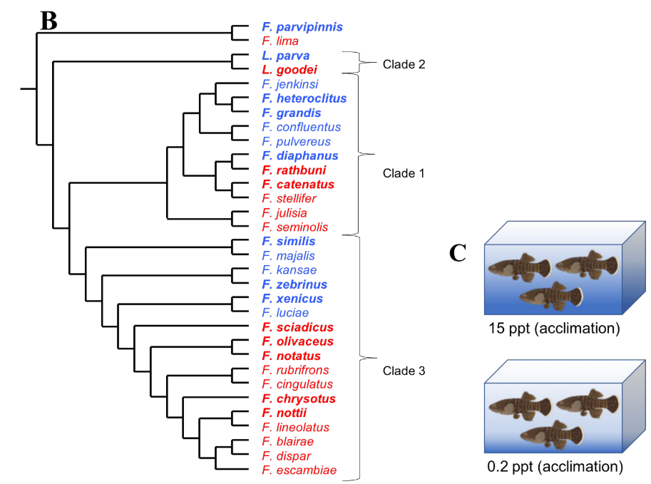
Evolutionary radiation of osmotolerant physiologies in killifish
physiology
stenohaline (freshwater)
euryhaline (saltwater)
Hyperosmotic tolerance is likely the ancestral physiological phenotype.
Freshwater-tolerant forms have evolved multiple times.
Whitehead 2010; Rodgers et al. 2018

Slide 20
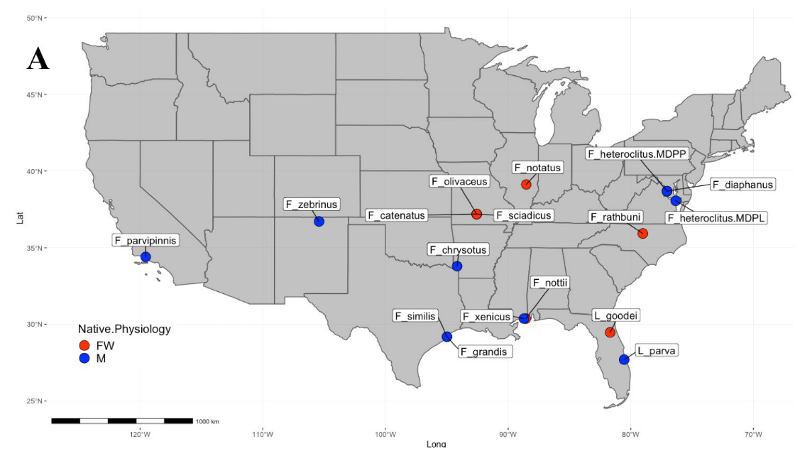
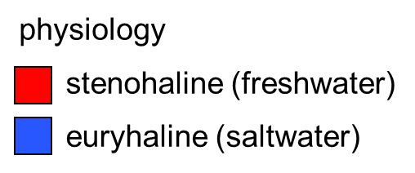
Evolutionary radiation of osmotolerant physiologies in killifish

Slide 21
Goal: Identify molecular mechanisms underlying transitions from euryhaline to stenohaline physiologies
2 experiments
3 main questions

Slide 22
Goal: Identify molecular mechanisms underlying transitions from euryhaline to stenohaline physiologies
Experiment #1: 2 week acclimation
0.2 ppt 15 ppt

Slide 23
Goal: Identify molecular mechanisms underlying transitions from euryhaline to stenohaline physiologies
Experiment #1: 2 week acclimation
0.2 ppt 15 ppt
3 replicates per tank × 14 species × 2 conditions = 84 gills sampled for RNAseq

Slide 24
Goal: Identify molecular mechanisms underlying transitions from euryhaline to stenohaline physiologies
Experiment #2: Transfer from 0.2 ppt to 15 ppt
0.2 ppt 15 ppt

Slide 25
Goal: Identify molecular mechanisms underlying transitions from euryhaline to stenohaline physiologies
Experiment #2: Transfer from 0.2 ppt to 15 ppt
0.2 ppt 15 ppt
3 replicates per tank × 14 species = 42 gills sampled for RNAseq

Slide 26
Questions:
What is the transcriptional response to change in salinity?

Slide 27
Questions:
What is the transcriptional response to change in salinity?
freshwater saltwater
1 species 1 physiology 2 conditions

Slide 28
Questions:
What is the transcriptional response to change in salinity?
gene expression
fresh salt
condition

Slide 29
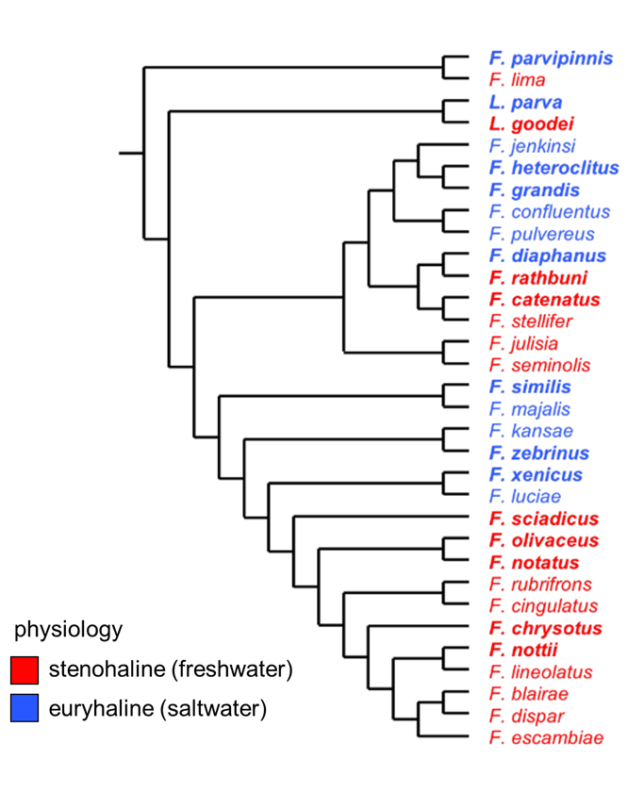
Questions:
What is the transcriptional response to change in salinity?
freshwater saltwater
1 species 1 physiology 2 conditions
14 species 3 clades 2 physiologies 3 conditions

Slide 30
Questions:
Which genes are responsive to changes in salinity across all species?
Important for osmotic stress tolerance in general.
euryhaline species 1
euryhaline species 2
stenohaline species 1
stenohaline species 2
gene expression
fresh salt
fresh salt
fresh salt
fresh salt
condition

Slide 31
Questions:
Which genes are responsive in euryhaline species that show no response in stenohaline species?
How have stenohaline species lost the ability to resist hyperosmotic stress.
euryhaline species 1
euryhaline species 2
stenohaline species 1
stenohaline species 2
gene expression
fresh salt
fresh salt
fresh salt
fresh salt
condition

Slide 32
Questions:
Which genes are responsive in euryhaline species that show opposite responses in stenohaline species?
How has gene expression evolved in opposing directions within lineages that experience osmotically stable environments.
euryhaline species 1
euryhaline species 2
stenohaline species 1
stenohaline species 2
gene expression
fresh salt
fresh salt
fresh salt
fresh salt
condition

Slide 33
Interesting questions, but… More species more problems

Slide 34
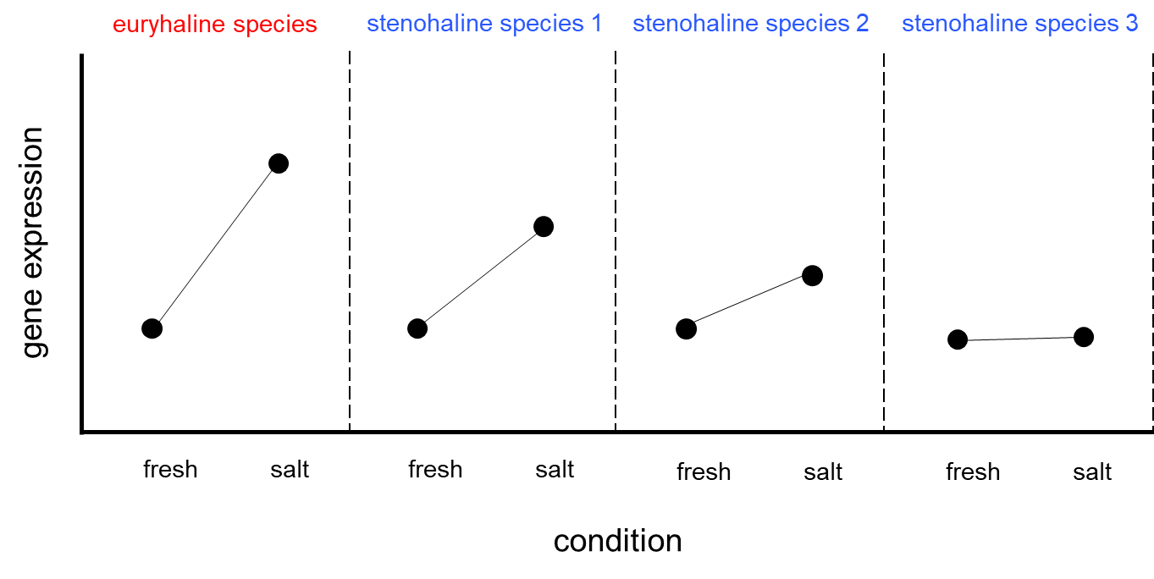
More species more problems
Problem #1: Phylogenetic non-independence.
3
stenohaline species 1
euryhaline species 1
euryhaline species 2
euryhaline species 3
1
2

Slide 35
Differential expression analyses with Limma
Solution: Mixed linear regression model that incorporates clade as a fixed effect and species as a random effect
clade 2
Y = β₀ + β₁X₁+ β₂X₂ + β₃X₃ + 𝛾₁ Ζ₁ + ϵ
clade 1
~ condition + physiology + clade + species
(fixed) (fixed) (fixed) (random)
covariate | levels
condition | (0.2 ppt, 15 ppt)
physiology | (euryhaline, stenohaline)
clade | (1, 2, 3)
species | (14 species)
clade 3

Slide 36
Differential expression analyses with Limma
Solution: Mixed linear regression model that incorporates clade as a fixed effect and species as a random effect
clade 2
Y = β₀ + β₁X₁+ β₂X₂ + β₃X₃ + 𝛾₁ Ζ₁ + ϵ +
(β₁X₁β₂X₂) + (β₁X₁β₃X₃) + (β₂X₂β₃X₃) +
(β₁X₁β₂X₂β₃X₃)
clade 1
~ condition + physiology + clade + species +
condition:physiology + condition:clade +
physiology:clade + condition:physiology:clade
clade 3

Slide 37
More species more problems
Problem #2: Increasing divergence relative to a reference transcriptome will bias expression downwards.
reference
cousin
reference
gene expression
cousin
fresh salt
fresh salt
condition

Slide 38
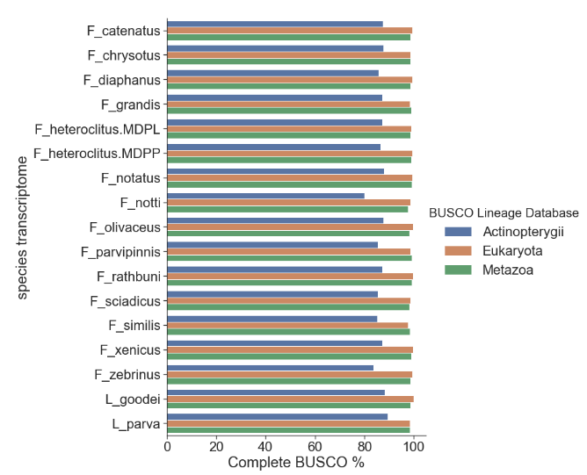
Trinity assemblies
Solution: Step 1. Be Lisa Johnson.
Step 2. Generate 17 de novo transcriptome assemblies.
11,000 gene annotations are shared across all assemblies (i.e. Ensembl IDs are the same).

Slide 39
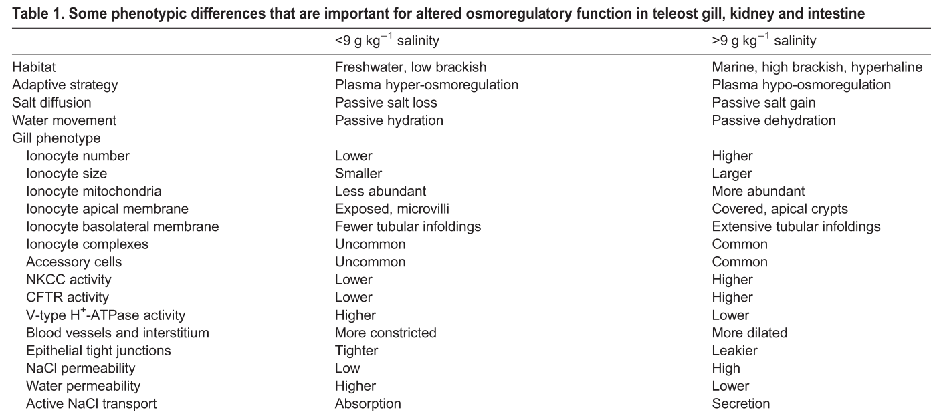
Predicted molecular responses
An ionocyte is a mitochondrion-rich cell within a teleost fish gill that contributes to the maintenance of optimal osmotic, ionic, and acid-base levels within the fish.
Kultz 2015

Slide 40
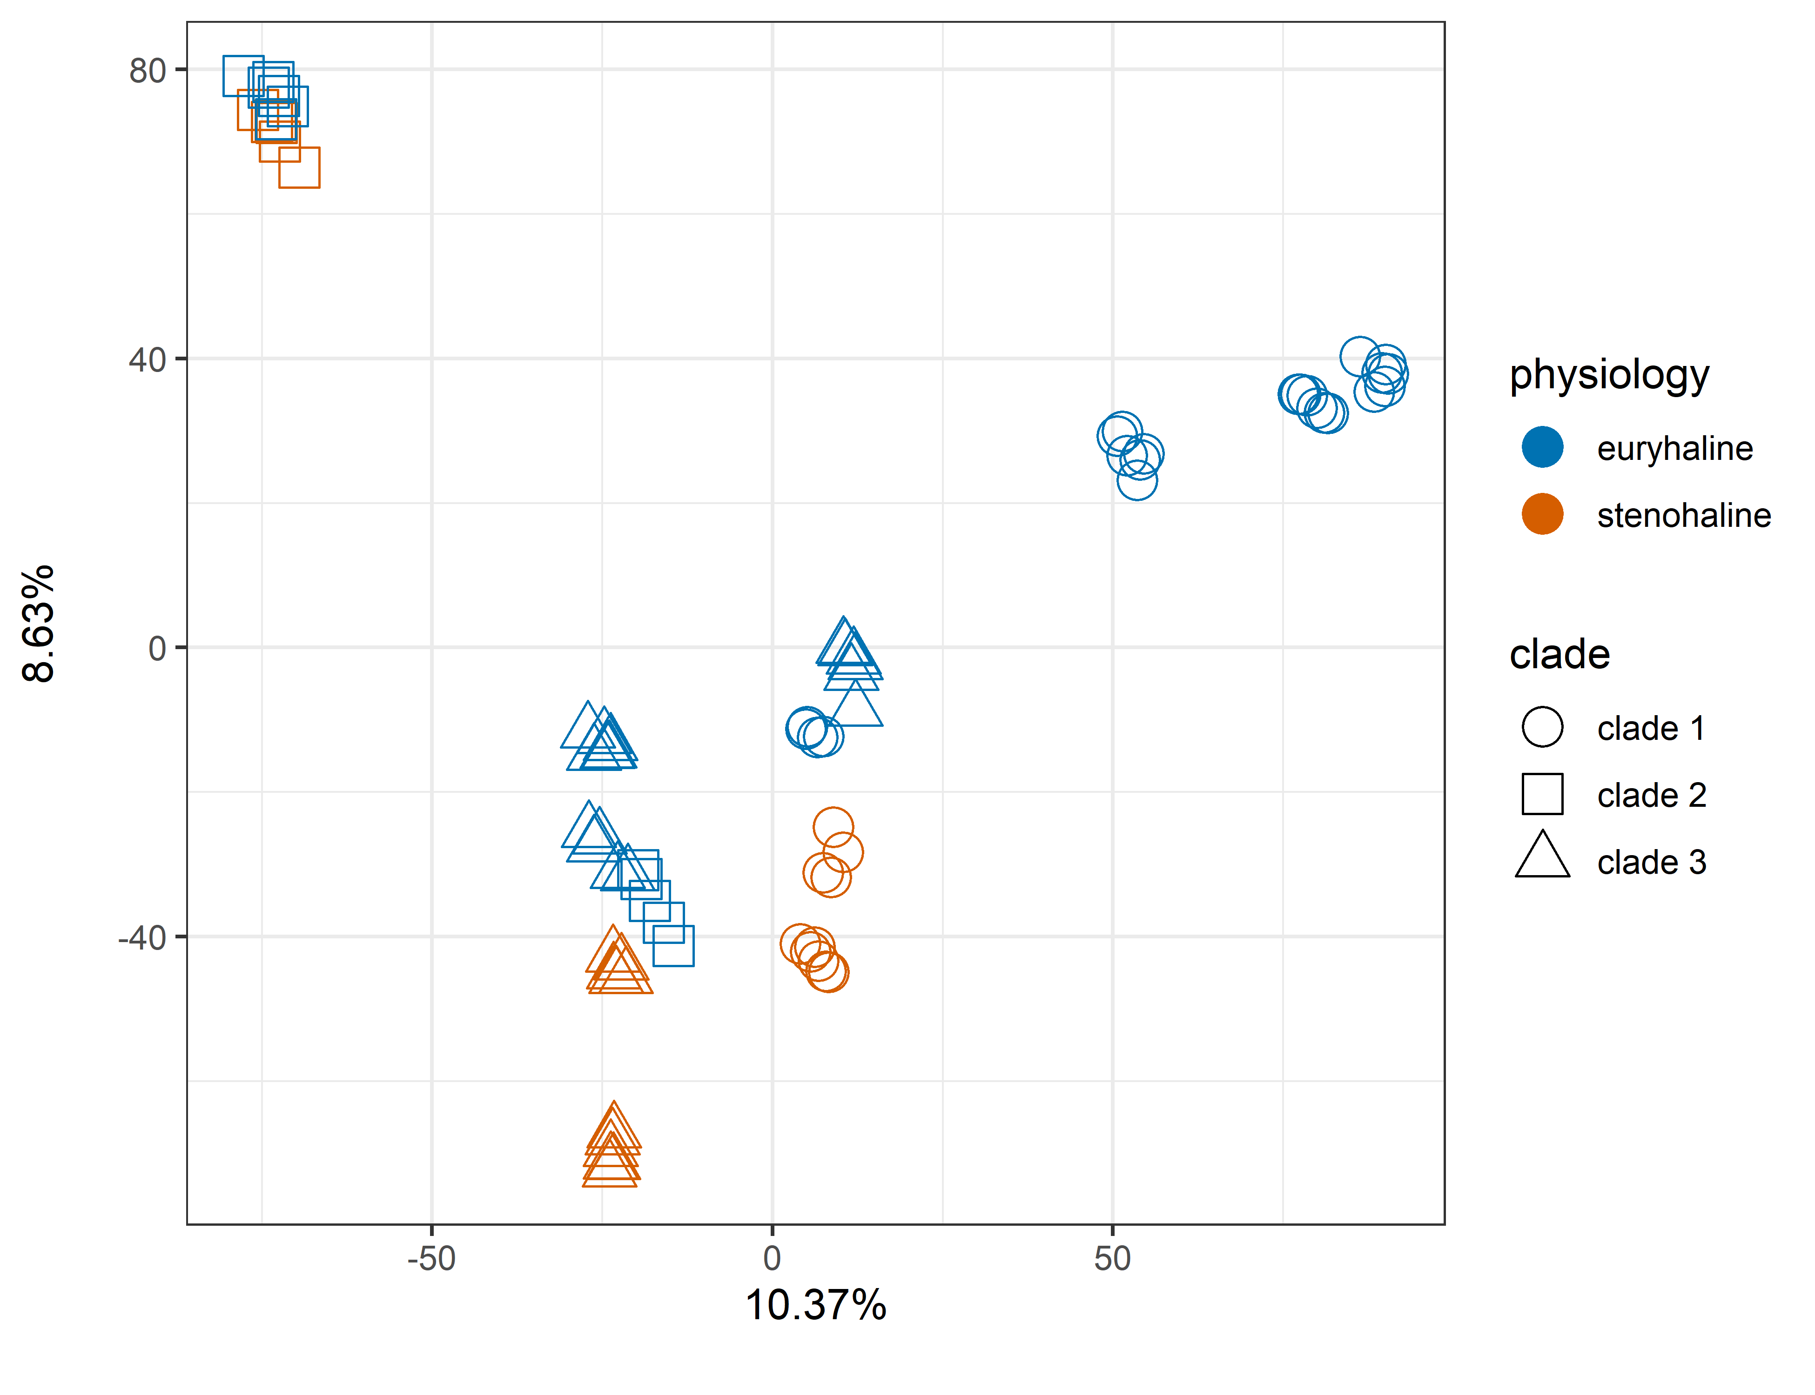
Results: PCA of all counts

Slide 41
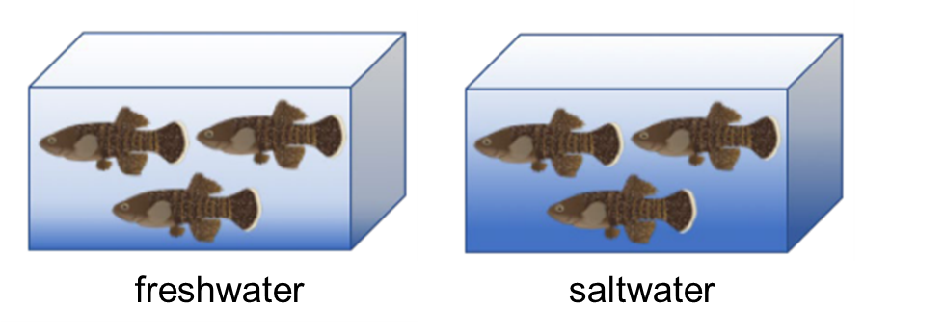
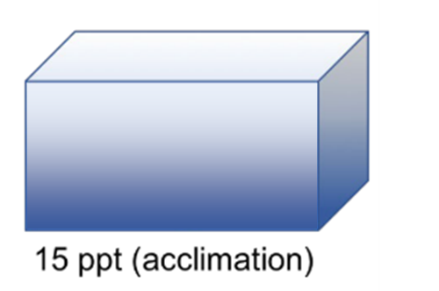
Results: Differential expression
acclimation
transfer
saltwater
covariate | levels
condition | (0.2 ppt, 15 ppt)
physiology | (euryhaline, stenohaline)
clade | (1, 2, 3)
species | (14 species)
covariate | levels
condition | (0.2 ppt, transfer)
physiology | (euryhaline, stenohaline)
clade | (1, 2, 3)
species | (14 species)

Slide 42
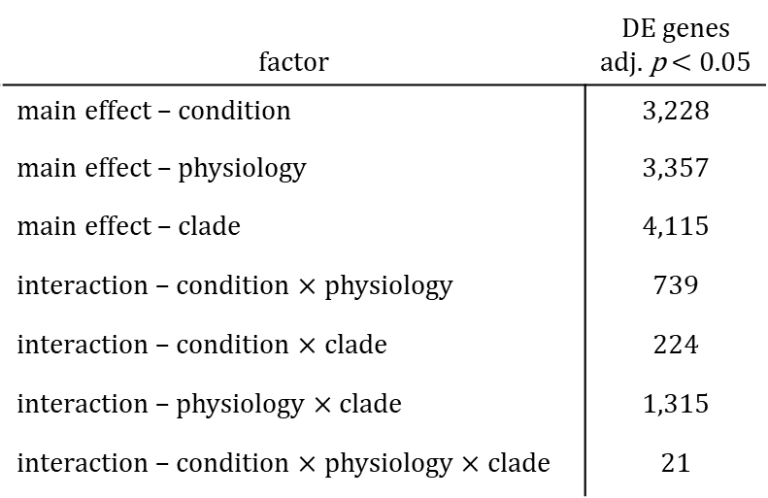
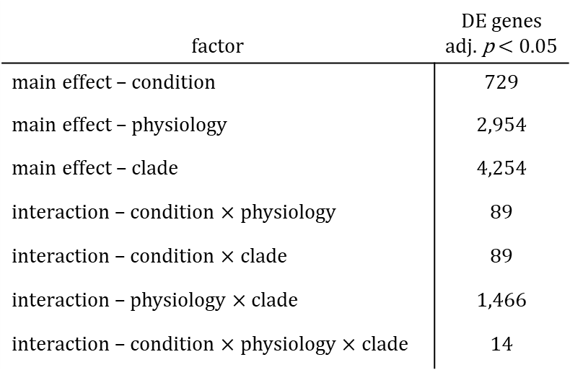
Results: Differential expression
acclimation
transfer
factor | DE genes adj. p < 0.05
main effect – condition | 729
main effect – physiology | 2,954
main effect – clade | 4,254
interaction – condition $×$ physiology | 89
interaction – condition $×$ clade | 89
interaction – physiology $×$ clade | 1,466
interaction – condition $×$ physiology $×$ clade | 14
factor | DE genes adj. p < 0.05
main effect – condition | 3,228
main effect – physiology | 3,357
main effect – clade | 4,115
interaction – condition $×$ physiology | 739
interaction – condition $×$ clade | 224
interaction – physiology $×$ clade | 1,315
interaction – condition $×$ physiology $×$ clade | 21

Slide 43
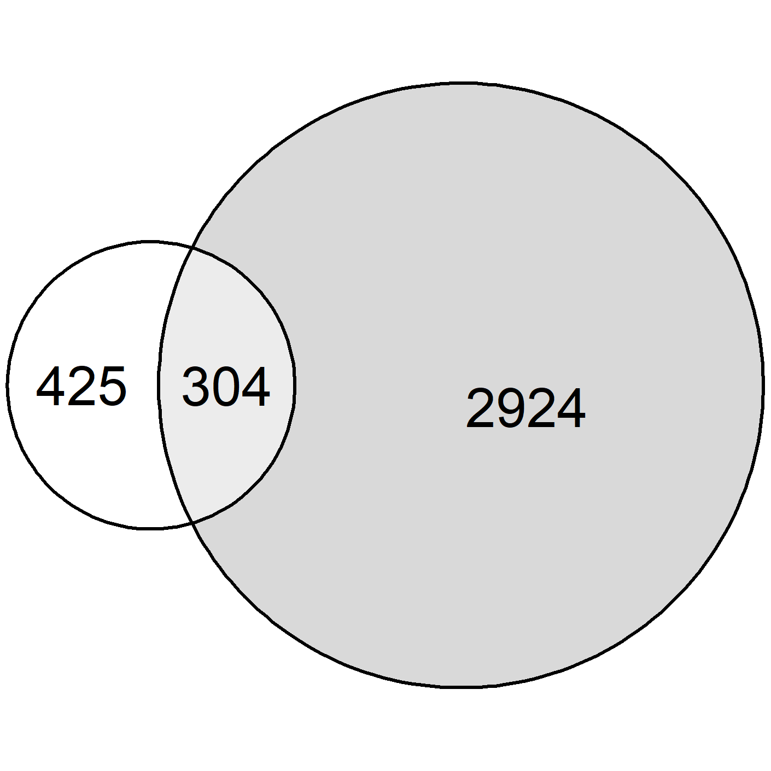
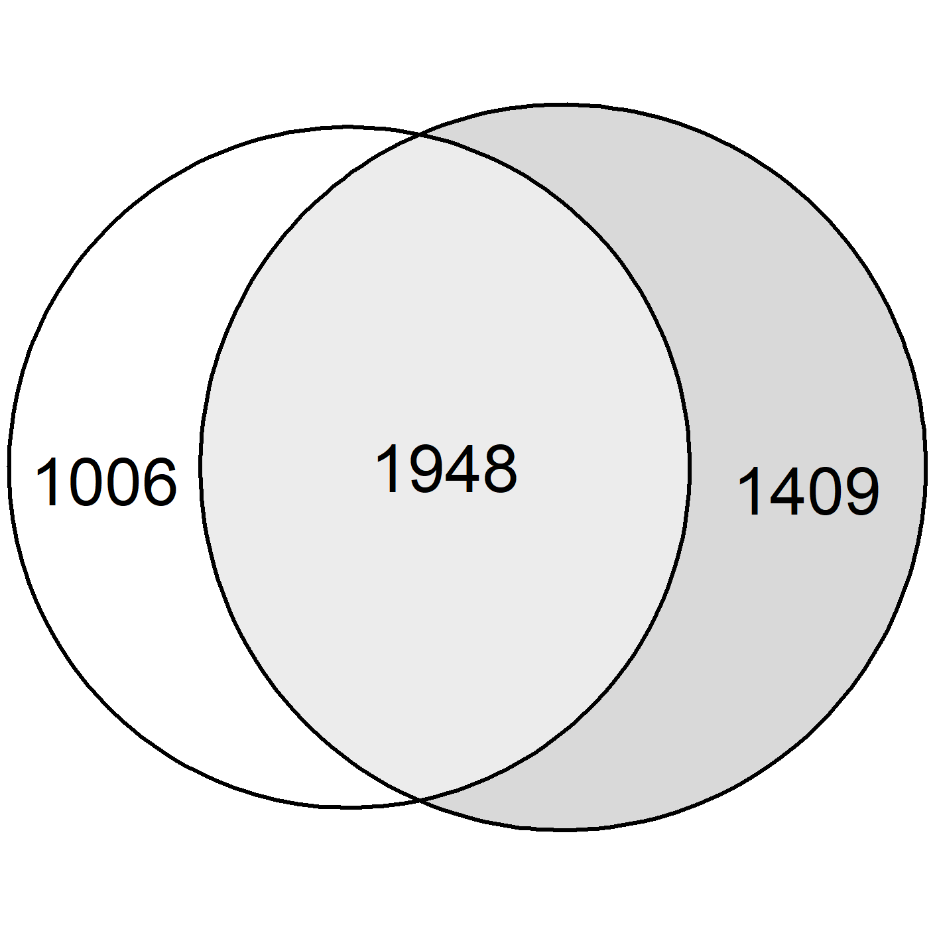
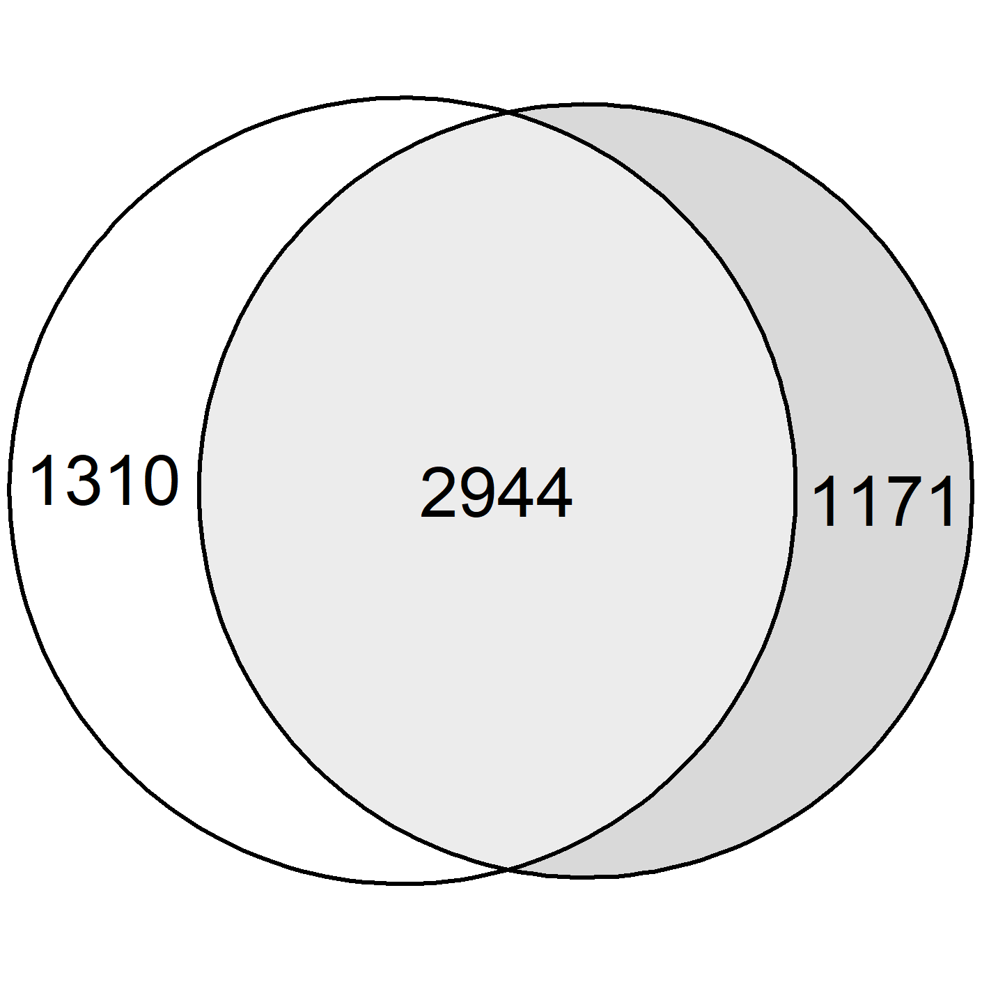
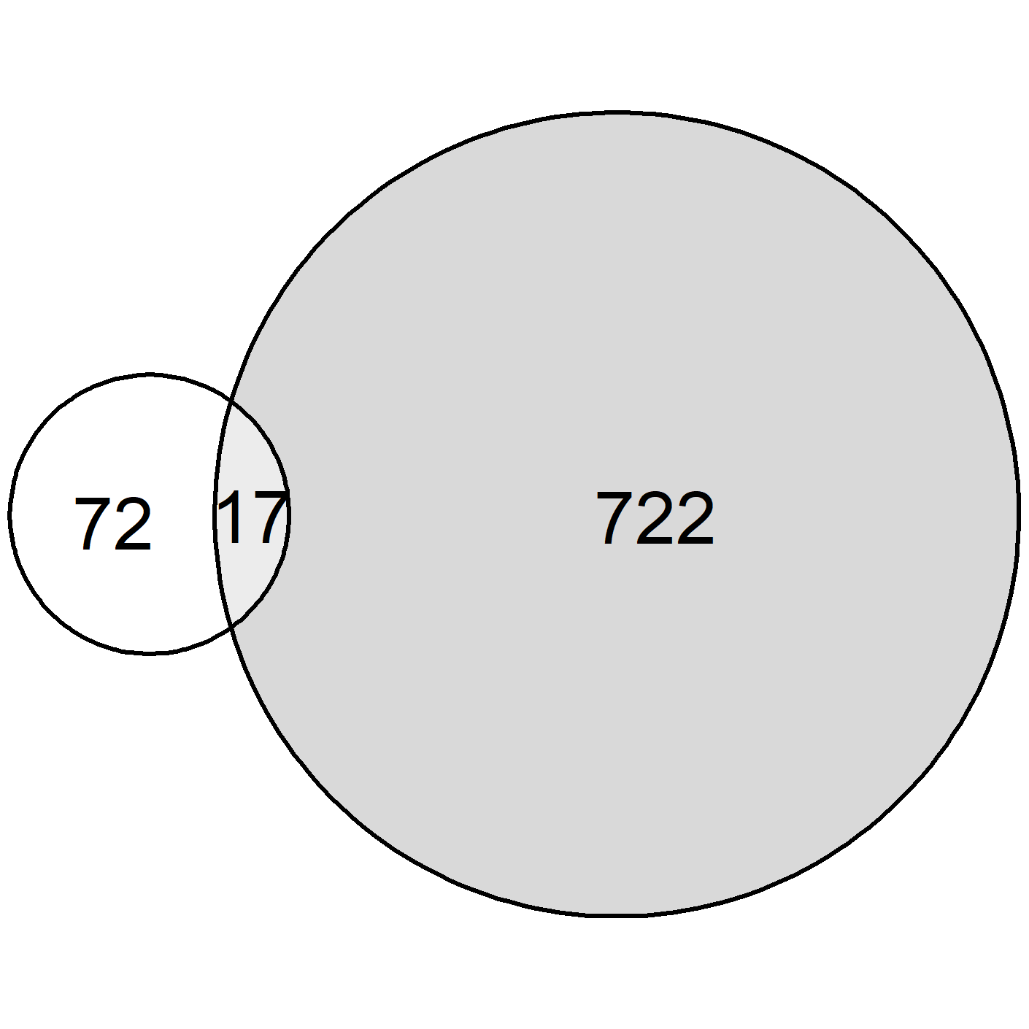
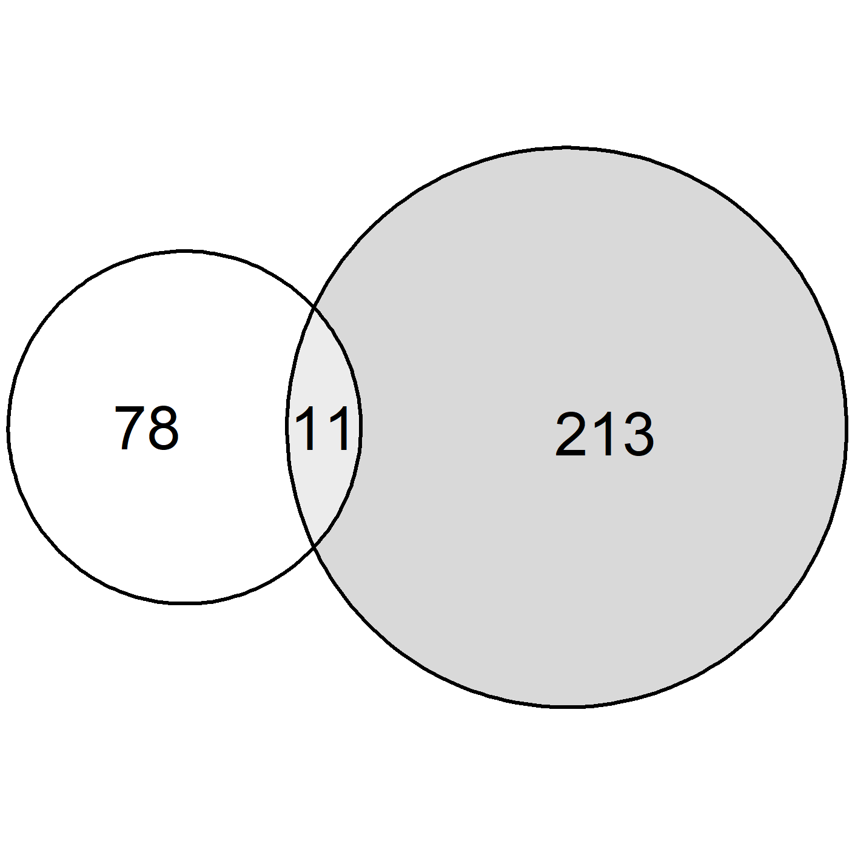
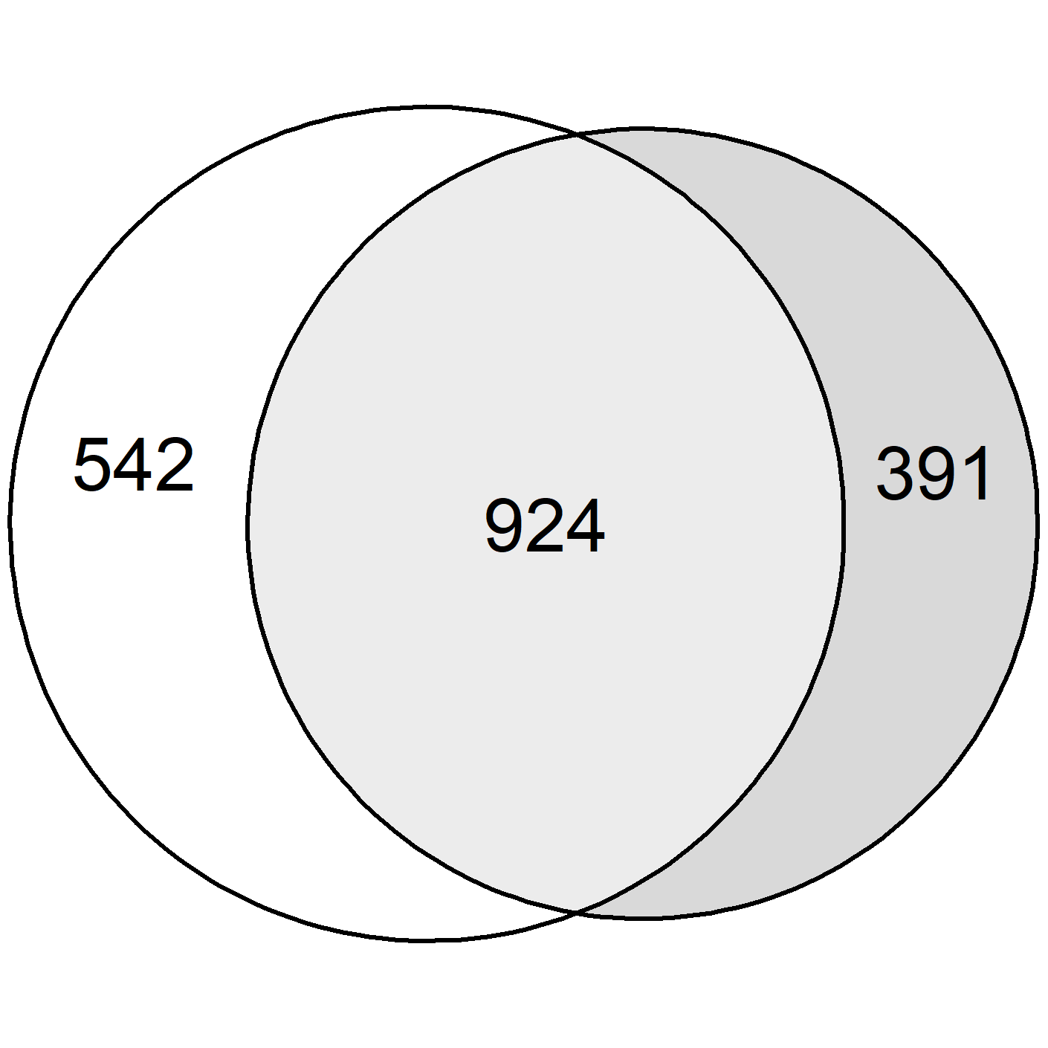
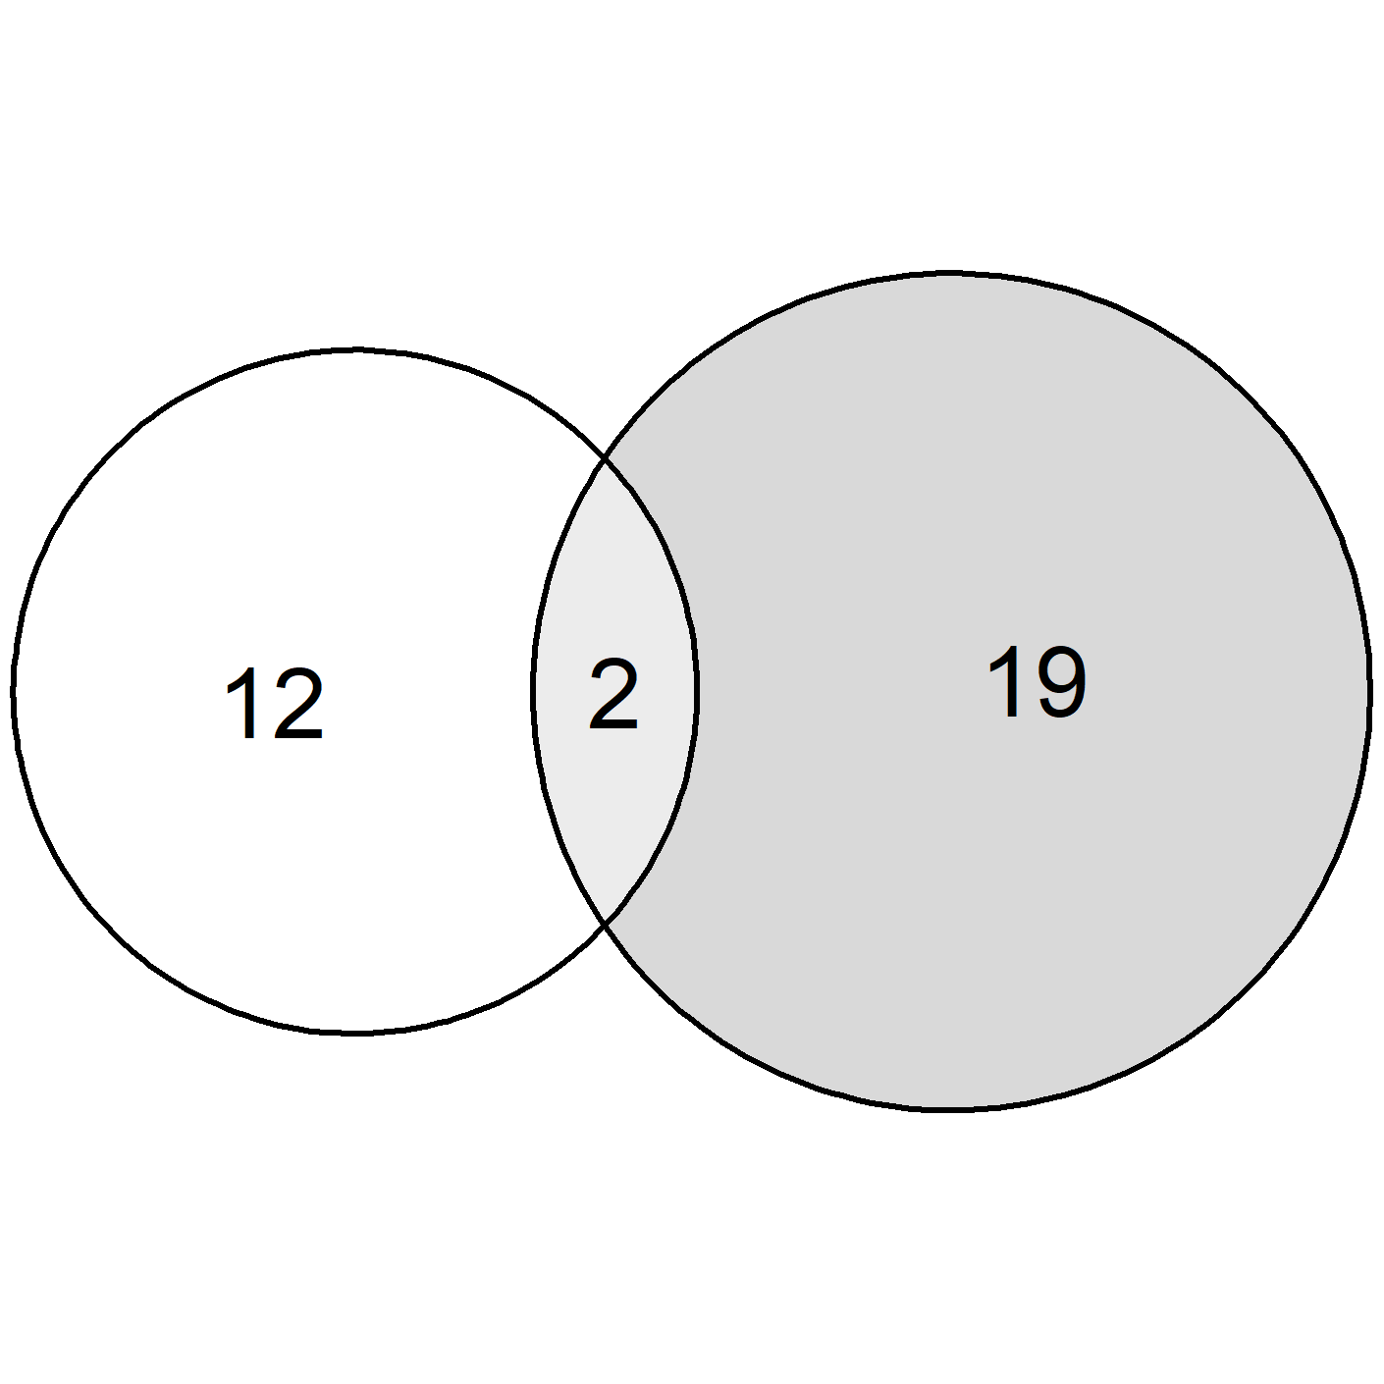
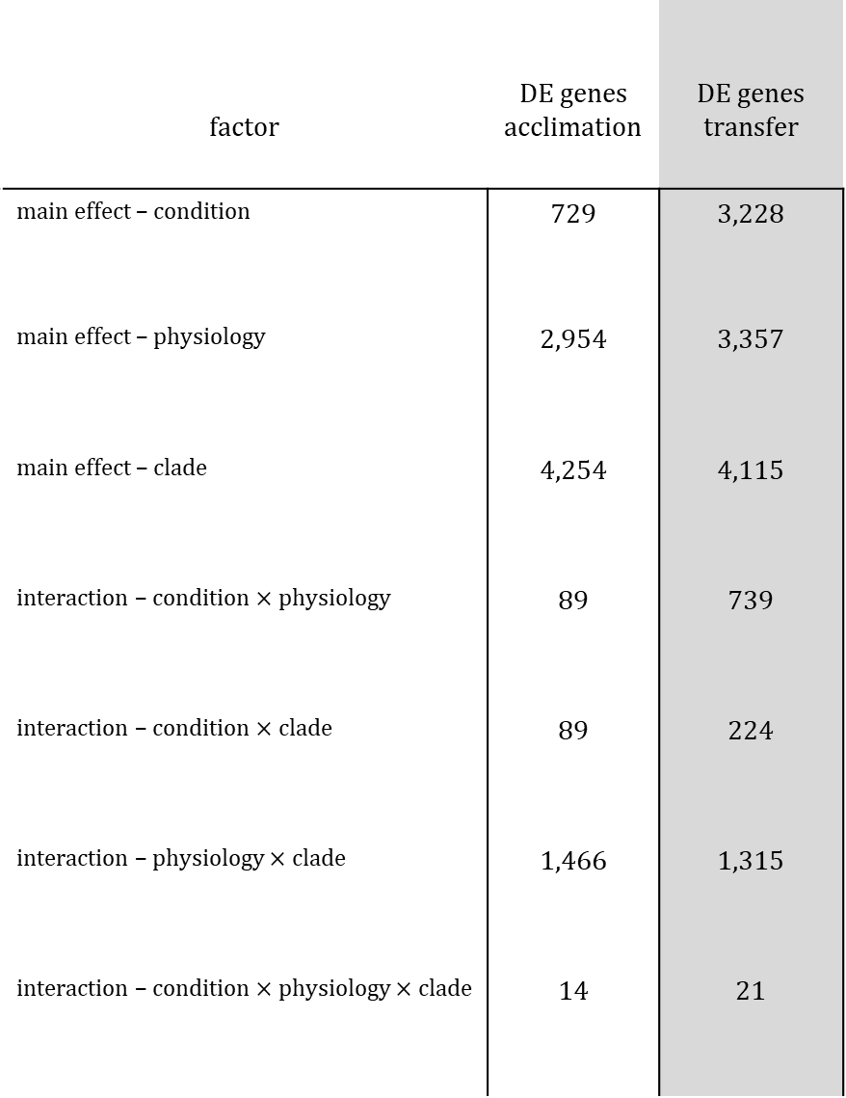
factor | DE genes acclimation | DE genes transfer
main effect – condition | 729 | 3,228
main effect – physiology | 2,954 | 3,357
main effect – clade | 4,254 | 4,115
interaction – condition $×$ physiology | 89 | 739
interaction – condition $×$ clade | 89 | 224
interaction – physiology $×$ clade | 1,466 | 1,315
interaction – condition $×$ physiology $×$ clade | 14 | 21

Slide 44
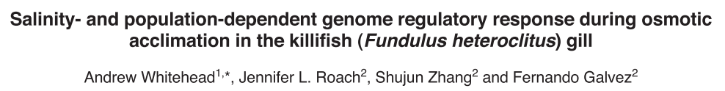
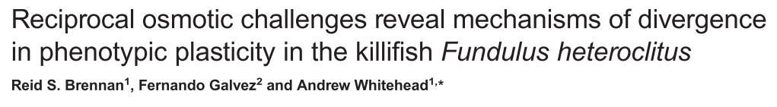
Results: Validating genes known to respond to salinity stress (cftr and aqp3)

Slide 45
factor | DE genes acclimation | DE genes transfer
main effect – condition | 729 | 3,228

Slide 46

Results: Validating genes known to respond to salinity stress (cftr and aqp3)
Acclimation experiment

Slide 47

Results: Validating genes known to respond to salinity stress (cftr and aqp3)
Transfer experiment

Slide 48

Results: Validating genes known to respond to salinity stress (cftr and aqp3)
Acclimation experiment

Slide 49

Results: Validating genes known to respond to salinity stress (cftr and aqp3)
Transfer experiment

Slide 50

Gill remodeling

Slide 51
Extra junk slides

Slide 52
Maintaining an internal osmolarity that is different from the environment
Freshwater Saltwater
Ion uptake
through gills
Ion export
through gills
Na⁺ Cl⁻
Na⁺ Cl⁻
Ionocytes: mitochondrion-rich cells in teleost fish gills that pump ions into or out of cells to maintain optimal osmotic levels

Slide 53
Some species are Euryhaline tolerate a large range of salinity stress
Freshwater Saltwater
Ion uptake
through gills
Ion export
through gills
Na⁺ Cl⁻
Na⁺ Cl⁻
Ionocytes:
smaller
less abundant
contain fewer mitochondria
Ionocytes:
larger
more abundant
contain more mitochondria

Slide 54





















Evolutionary radiation of osmotolerant physiologies in killifish
http://names.killies.palo-alto.ca.us/sys/genus?Fundulus

